Slide 1

Analysis of Mexico City's Venues
By: Marco Xoca

Slide 2
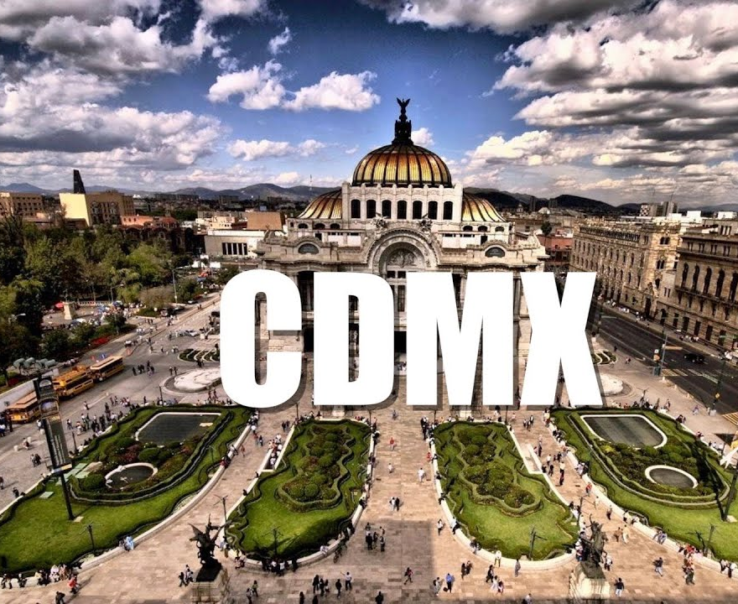
Introduction
Mexico City is the capital, largest city, and most populous city in North America. This city is also one of the most important and cultural centers in the world.
By 2015 the estimated population was about 9,000,000, also Mexico City, or CDMX has 16 municipalities
In this project I'll find the information about landmarks, restaurants, shops, and more venues of each municipalities, in order to help people to find the best municipality to visit according at their interest

Slide 3
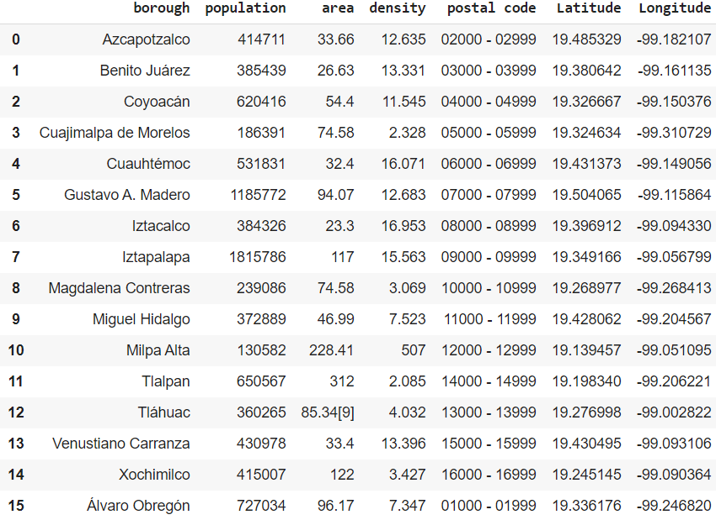
Data
In order to get all the information needed, we can list the data as below:
List of each municipality in CDMX
Coordinates (latitude and longitude) of each municipality in CDMX
List of every venue by municipalities (obtained through Foursquare API)
After the preprocessing and cleaning, the dataframe was the one in the right.

Slide 4
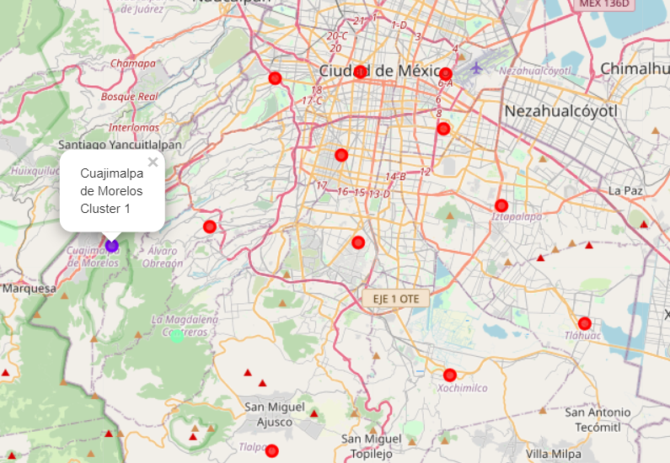
Methodology
I got the geographical coordinates of Mexico City, which were: longitude = 19.4326296 and latitude = -99.1331785
With these coordinates, and using Folium's package, I made a map of the CDMX, with labels at each municipality.

Slide 5
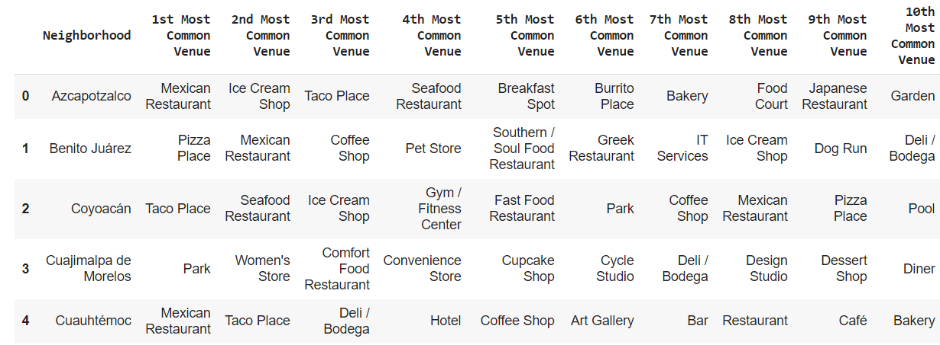
Methodology
Once having the CDMX’s map, with the help of Foursquare API I got all the venues available by municipality (neighborhood), and the top 10 venue category by municipality

Slide 6
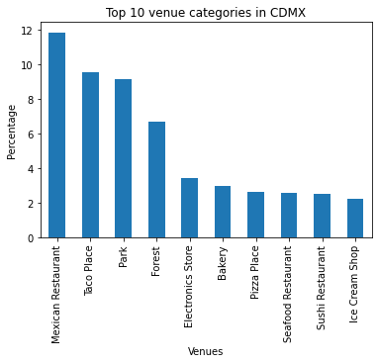
Methodology
Using the one-hot encoding, and with the frequency dataframe, I made the follow dataframe with the top 10 most common venue in all the city

Slide 7
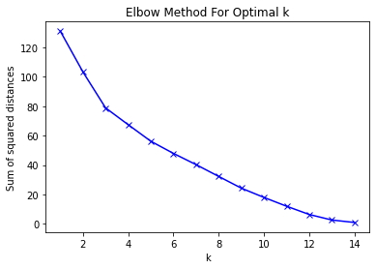
Clustering: Elbow’s method
One step just before to start clustering, is to know how many clusters (or the k value) are the optimal for this problem.
I made a plot of the sum of squared distances with different k-values

Slide 8
Clustering: with k=3
Using the KMeans library, I divided all the venues data in 3 clusters.

Slide 9
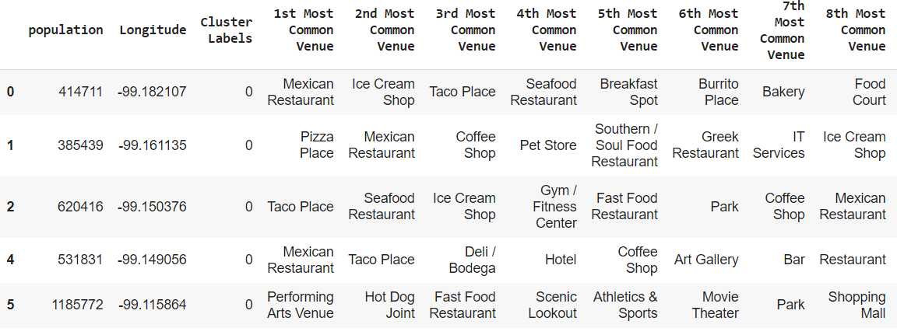
Results
Seeing all the tables and maps, we can notice that almost all the venues are just in one cluster, which has a big relation in the urbanized area
Also, we can explore venues by cluster, like the venues in cluster 1 order by common

Slide 10
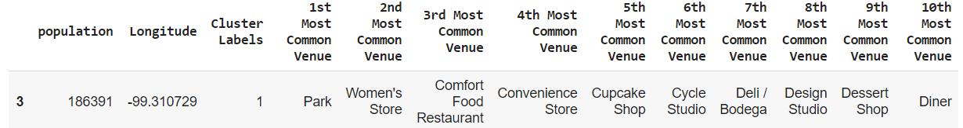
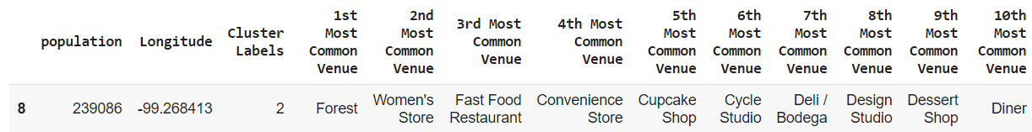
Results
Cluster 2 and 3 are respectively:

Slide 11
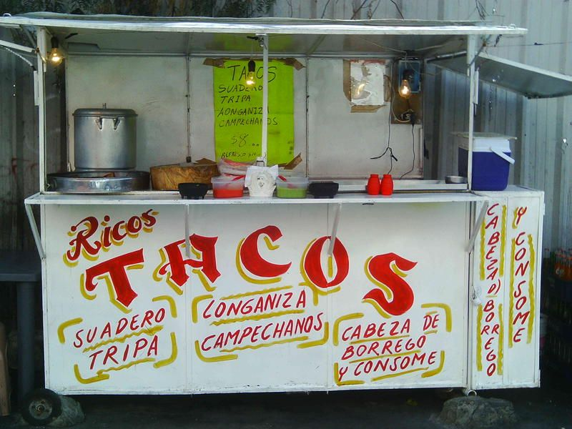
Discussions
As we can see in the last three figures, if we like to eat Mexican food, pizza or go to arts venue, we should go in the cluster 1 areas. Otherwise, if we like to visit parks, we should go to cluster 2 areas. Finally, if we like to go to the forest, we should go to cluster's 3 areas.
We can notice that in all CDMX, the most common venues are, obviously, Mexican restaurants, followed by Taco places, parks and forest, being such a good place to free activities and good food places.
Being Mexico City one of the bigger cities in the world, probably it is better to analyze venues by municipality. Also, foursquare has not a lot of data of CDMX’s venues, so it would be a great idea using another venues API, like the Google’s one, or a local government API to get all the necessary data to a better analysis

Slide 12
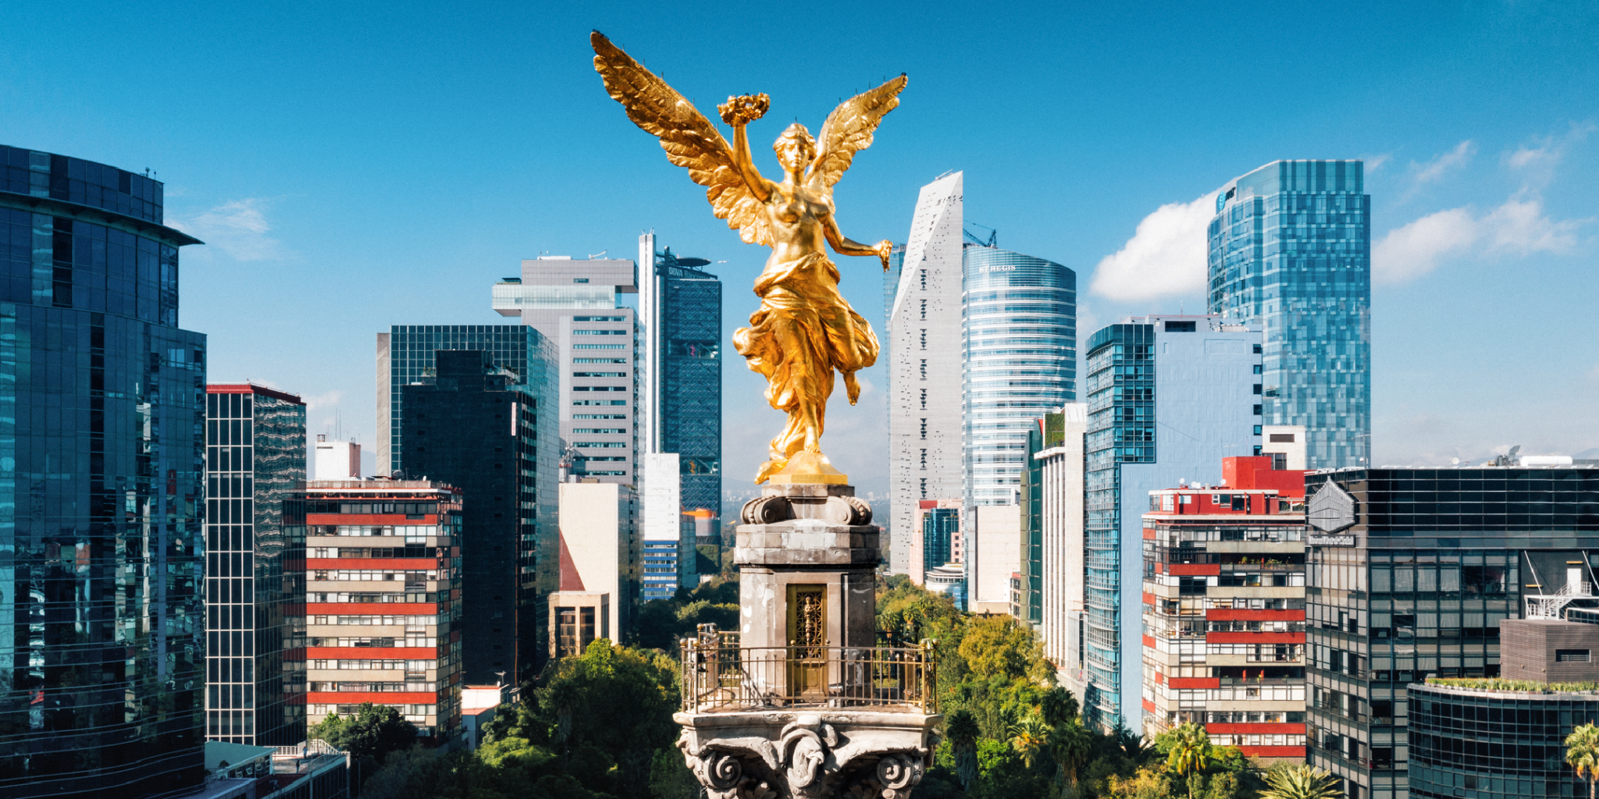
Conclusion
With all this analysis we can conclude that, according to our likes, we can visit different municipalities of CDMX.
If we like all kind of restaurants, we should go to any area in cluster 1, if we like to go to a park or shopping, we should go to any area in cluster 2, showed by the violet label.
Finally, if we like to go to a forest, shopping, or food restaurant, we should go to any area in cluster 3.
This kind of analysis is very useful if we like to visit a new city, but we have no idea what to expect, and with this we can cluster our favorite places and planning in a better way our travel.
Also, this analysis is very straightforward, and you don’t need to be the grater programmer of all time in order to do a very well-made analysis and clustering of venues

